Slide 1
The Origin and Growth of Liberalism
Unit Two

Slide 2

Unit 2
Where do we come from?
What are we?
Where are we going?
To understand what liberalism is and how it affects us we must
examine the
development and
history of liberalism.

Slide 3
Uncovering 19th Century Liberalism
Chapter 3

Slide 4
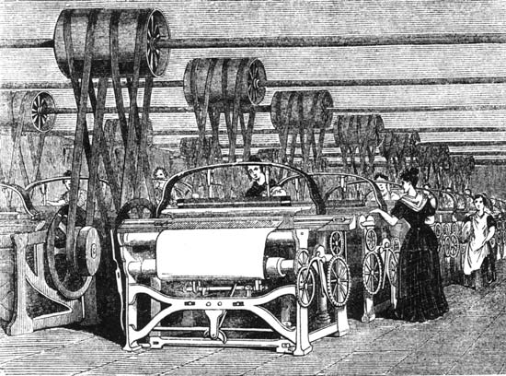
To what extent can classical liberalism impact a society?
Classical liberalism puts greater focus on individual freedom
Classical
liberalism
originated in
Great Britain.

Slide 5
Classical Liberalism
Stresses the importance of human rationality
Classical Liberalism is an ideology that embraces the principles of individualism.
  Rule of Law
  Rights and Freedoms
  Private Property
  Economic freedom
  Self-interest
  Competition
Classical liberalism means the original ideals or liberalism
Liberty essentially means ‘freedom’, therefore liberalism is an ideology based on freedom

Slide 6
Classical liberalism values political freedom and a free market economy that has limited government intervention within the economy.
Modern liberalism is different because it advocates a greater role for the state in society.
Therefore
Modern Liberalism:
Proposes government regulations with in the economy
Classical liberalism
Proposes less government involvement with the economy

Slide 7
Development of Classical Liberalism
The following events help shape classical liberalism:
  Renaissance
  Enlightenment/Age of Reason
    Humanist
  Protestant Reformation
  American Revolution
  French Revolution
  Industrial Revolution

Slide 8
1400-1600 The Renaissance
  Awareness of individualism grew
1517- The Protestant Reformation
  Growing secularism
1700’s- The Enlightenment/Age of Reason
  Democratic values were strengthened
1750-1850- Industrial Revolution
  Economic freedom grew along with individual values.
1776- American Revolution
1789- French Revolution
1900’s- Liberalism

Slide 9
Renaissance
The Renaissance fostered the belief of individualism in society
The Reformation built on the ideas of the Renaissance by transforming the Christian faith through the importance of reason.
Ultimately both of these events fueled the Enlightenment or the Age of Reason, and as a result Classical Liberalism was born.
Within the Enlightenment a group of Italian and French philosophers called Humanists, emerged.
  Humanist developed an interpretation of history, structure of society and life based on reason and logic opposed to religion.

Slide 10
Protestant Reformation
The Reformation dramatically altered the political, economic and social circumstance of Europe by opposing the Catholic Church.
  It also challenged the hierarchical concentration of religious power and any corruption of this power at this time.
  Many high priests at the time asked peasant for donations in order to ensure their acceptance into heaven. Ex Notre Dame

Slide 11
Enlightenment
The Enlightenment was a time period of great political and economic change which was proposed by thinkers and philosophers of the era.
REMEMBER:
European society at the time was divided into 3 classes or estates
Estate 1
Church
Estate 2
Nobles
Estate 3
Merchants / Peasants

Slide 12
At this time Kings ruled by Divine Right and the economy was organized by the feudal system.
With the ideas of the Enlightenment came the breakdown of the feudal economic order, since people became more involved in oversea trade, urbanization grew and a wealthy middle class emerged. (industrial Revolution)
At the same time there was political struggles for a less authoritarian rule which challenged the status quo.

Slide 13
As a result Classical liberalism emerged which was a political and economic philosophy that encouraged:
    The primacy of individual rights and freedoms
    The belief that humans are reasonable and can make rational decisions that will benefit both themselves and society as a whole
    Economic freedom, involving the ownership of private property and free markets (markets with limited government intervention)
    The protection of civil liberties
    Constitutional limitations on the government

Slide 14
Thinkers of the Time
The following thinkers of the time contributed to the ideology of liberalism:
  Thomas Hobbes
  John Locke
  Jean-Jacques Rousseau
  Charles de Secondat, baron de Montesquieu
  Adam Smith
  John Stuart Mills

Slide 15
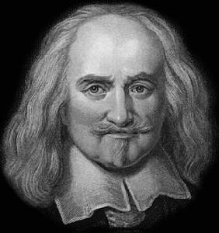
Thomas Hobbes (1588-1679)
Review
English Philosopher
He believed human nature is characterized by fear, violence, and dangerous self-interest (extreme individualism)
He believed that if everyone is free, then everyone is in danger; that security is more important than freedom
He did not think it was possible to have both security and freedom
Individuals must give up their sovereignty in exchange for security.

Slide 16
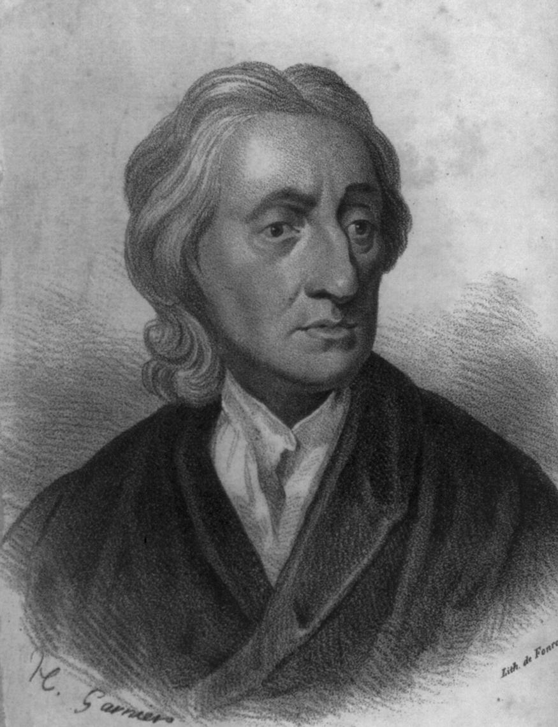
John Locke (1632-1704)
Also an English philosopher
Unlike Hobbes, Locke believed humans are
rational, intelligent, and reasonable.
Locke opposed the authoritarianism of the Church and the state and believed that individuals had the right to use their reason and logic to make their own decisions.
He also believed the source of power was the people themselves.
He believed that any government action had to be justified by popular consent (democracy).
However he believed in the social contract where people must give up some of their rights to a government for social security.

Slide 17
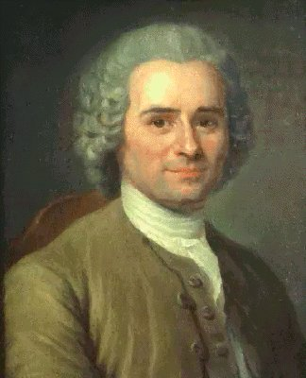
Jean-Jacques Rousseau
(1712-1778)
Swiss Philosopher
Believed people are inherently good but have been corrupted by society and civilization
Believed men are naturally free and equal
Wanted humans to go back to these natural, good characteristics
He believed the will of the people was the absolute authority but, unlike Locke, did not believe in representative democracy, but in a direct democracy
He believed citizens should make the laws directly

Slide 18
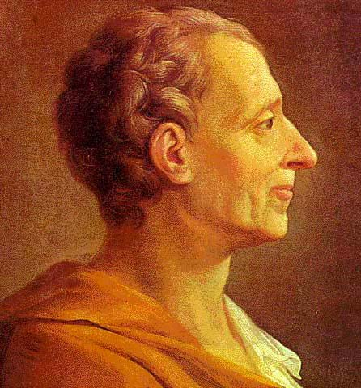
Charles de Secondat, baron de Montesquieu
(1689-1755)
French Enlightenment thinker whose
writings were banned by the Catholic church
Montesquieu believed in the worth of the individual, the equality of individuals, and the accountability of the government.
He also believed strongly in the separation of powers in government (executive, legislative, and judicial).
Within this system of Checks and Balances each branch would be both separate from and dependent on one another so that no one branch became too powerful.
However in order for this system to work people needed to be involved in government-a democracy.

Slide 19
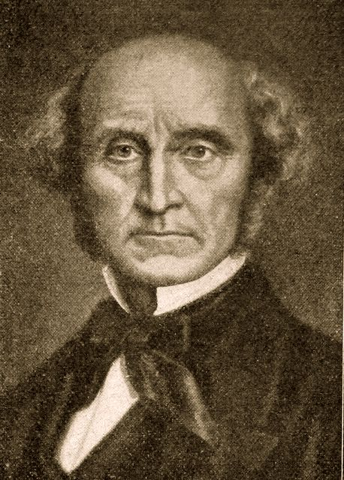
John Stuart Mill
(1806-1873)
English philosopher
He was interested in the protection of
individual freedom and the promotion of individual decision making as the core of societal institutions
He believed that the only limitations that should be placed on the individual were those that would protect others (i.e. The only restrictions on people should be those that prevent harm to others)
Mill also strongly advocated free speech

Slide 20
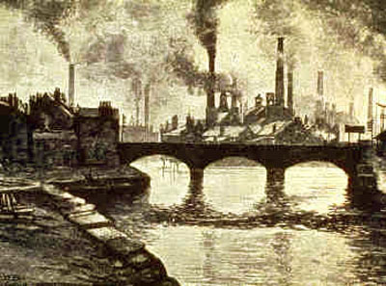
Industrial Revolution: The Origins of Laissez-Faire Economics
In approx 1750 the Industrial Revolution occurred in Great Britain.
Britain’s economy was traditionally based on agriculture however during the Industrial Revolution this changed to a factory based system in urban centers.

Slide 21
Industrial Revolution in Great Britain
The Industrial Revolution began in Great Britain for the following reasons:
  Great Britain had a large naval and merchant fleets that could be used to trade with other areas of the world and gain resources of distance colonies.
  Britain also had a large investment capital and cheap labour with many inventors causing new technology.
  Power was shared between the parliament and the monarchy. Parliament was made up of powerful land owners. This lead to the Enclosure Act which privatized farm land forcing thousands of small farmers to the cities looking for work.
  Britain and the world were influenced by the Enlightenment thinkers which favoured capitalism

Slide 22
Results of the Industrial Revolution
Together these resulted in:
  The development of the factory system
  Mechanization of labour
  Mass production
  Consumption of consumer goods
  Expansion of capitalism and free enterprise
  A large gap between the extremely rich and the extremely poor
  Slums
  Starvation
  Child labour and worker abuse along with
  The degradation of the environment

Slide 23
Laissez-Faire Economics
French term- “leave (people) alone to do (as they wish)”
It referred to a reduction of government involvement in the economy
It emerged from the theories of the physiocrats.
  a group of Enlightenment philosophers in France who critiqued the prevailing economics of mercantilism.
  Mercantilism is the idea that the primary goal of the economy is to strengthen the power and wealth of the state. In order to do so high government regulation is necessary.

Slide 24


Laissez-faire reflects the following ideas:
  Individuals nee to be given freedom to make their own decisions. Therefore laissez-faire is contradicting mercantilism.
  Individuals’ selfishness and competitiveness will eventually improve their own society.

Slide 25
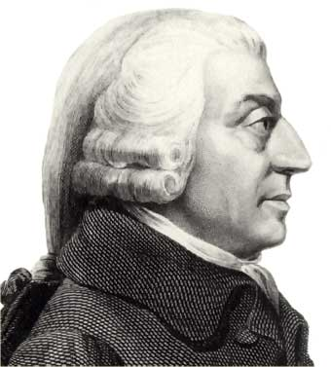
Adam Smith
(1723-1790)
Scottish political economist
He believed that if people worked first and foremost for themselves, everyone-including the state-would be better off.
He published The Wealth of Nations (1776) in which he insisted individual self-interest in a free-market would strengthen the economy and benefit most people.
He provided the foundation of much of the capitalist system

Slide 26
Complete the chart and answer questions 2 and 3 on p113
Thinkers | Beliefs | How their ideas were radical at that time | How their ideas are related to classical liberalism
Hobbes
Locke
Montesquieu
Smith
Mill

Slide 27
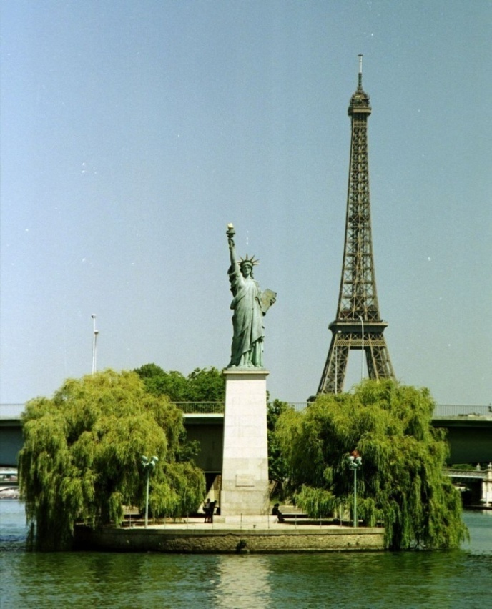
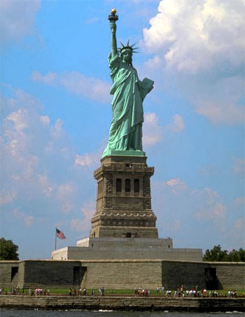
The Evolution of Classical Liberal Thought
How did classical liberal thought evolve into the principles of liberalism?
The American and French Revolutions in the late 1700s were attempts to implement the ideas of liberal thought.

Slide 28
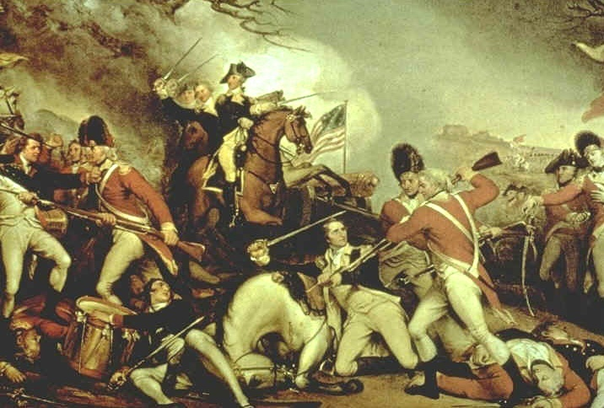
The American Revolution
Liberal thinkers inspired the American colonists to declare independence from the British crown and establish a republican form of government where governing authority was invested in the hands of its citizens and not a ruling monarch.

Slide 29
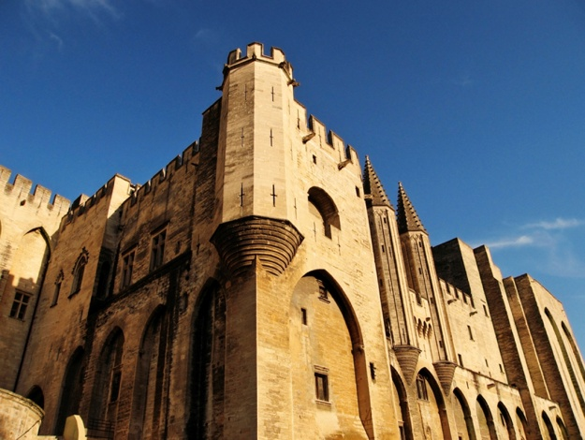

The French Revolution
Following the American Revolution, the French Revolution was an attempt to transform society using liberal principles.
Recall reasons for the French Revolution...
  Social: The class system of the 3 estates
  Political: people had no say within the government and Estates General failed
  Economic: unequal taxation, expensive wars, lavish spending of the king.

Slide 30
Compare liberalism to The Declaration of the Rights of Man and of the Citizen...
  “men are born and remain free and equal in rights...”
  “Rights are liberty, property, security and resistance to oppression..”
  “Liberty consists of freedom to everything which does not injure anyone else..”
  “Law is the expression of the general will..”
  “Free communication of ideas and opinions is one of the most previous of the rights…”

Slide 31

Aboriginal Influence on Liberalism in North America
The Great Law of Peace, or the Constitution of the Haudenosaunee Confederacy, established equal participation of the people, including women, in the government. It also guaranteed certain rights and freedoms, including freedom of speech and the rights of individuals.

Slide 32
Homework
Read Voices on p 116- 117.
  Then complete the accompanying questions.
Complete “Explore the Issue” on p 118
  Do questions 1,2,3

Slide 33
Liberal Principles in Action
The principles of classical liberalism had become widespread in Western societies by the 19th century.
This was the culmination of the political, economic, and social dynamics of the previous centuries.
It culminated in with industrialization and capitalism
This eventually led to the evolution of classical liberalism into modern liberalism

Slide 34
The Industrial Revolution circa 1750-1900
The Industrial Revolution was...“the most far-reaching, influential transformation of human culture since the advent of agriculture eight or ten thousand years ago. The consequences of this revolution would change irrevocably human labour, consumption, family structure, social structure, and even the very soul and thoughts of the individual.” -Richard Hooker
How are liberalism, capitalism, and industrialization linked?

Slide 35
Enclosure movement was created because of new technologies such as the seed drill.
This movement pushed many people to the cities because they were not needed any more.
Deregulated mercantilist system caused a free-trade approach to the economy which provide more capitial for the Industrial Revolution to occur and spread.

Slide 36
Let’s look at the connections...
The Enclosure movement led to the industrial revolution...how?
Liberalism essentially means ‘freedom.’ In what way did the Industrial Revolution allow people more freedom than agriculture or the feudal system?
For homework...
Read the Voices section on page 123 and answer questions 1 & 2.

