Slide 1
Chapter 10: Challenging Liberalism
So 2.10

Slide 2
What ways of thinking can challenge liberalism?
In society, different and sometimes conflicting visions of what life should be like are proposed.
This means that sometimes the values of Liberalism are supported, and sometimes they are challenged.

Slide 3
Key Values of Liberalism:
Individual rights and freedoms
Self-interest
Rule of law
Economic freedom
Private property
Sometimes the values of liberalism are challenged by alternative thought or ways of thinking such as: political ideologies (fascism, feminism, socialism, communism),

Slide 4
Three ways of thinking that can challenge liberalism
1.
Aboriginal Perspectives and ways of thinking
2.
Religious Perspectives and Ways of thinking
3.
Environmentalism and Collective Ways of Thinking

Slide 5
Aboriginal perspectives and ways of thinking

Slide 6
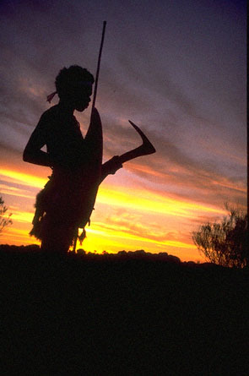
1. Aboriginal perspectives and ways of thinking
Aboriginal collective thought reflected valuing the group more so than the individual, the interconnectedness of all living things, and a shared ownership of the land, collective interest.
This was in contrast to
European explorers’ ways
of thinking
(individualism, self-interest)

Slide 7
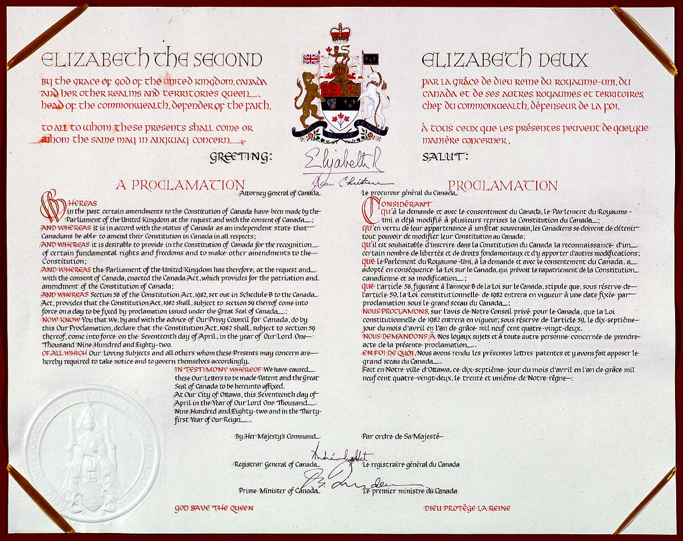
Constitution act - 1982
Aboriginal collective rights were specifically included in Section 35 of the Constitution Act (Right of the Aboriginal Peoples of Canada) and in Section 25 of the Constitution Act within the Canadian Charter of Rights and Freedom

Slide 8
Constitution act - 1982
The constitution reflected a shift in thinking by governments in Canada and provided First Nations, Inuit, and Metis peoples with recognition of their collective rights and the legal grounds to challenge the denial of their rights by governments in Canada

Slide 9
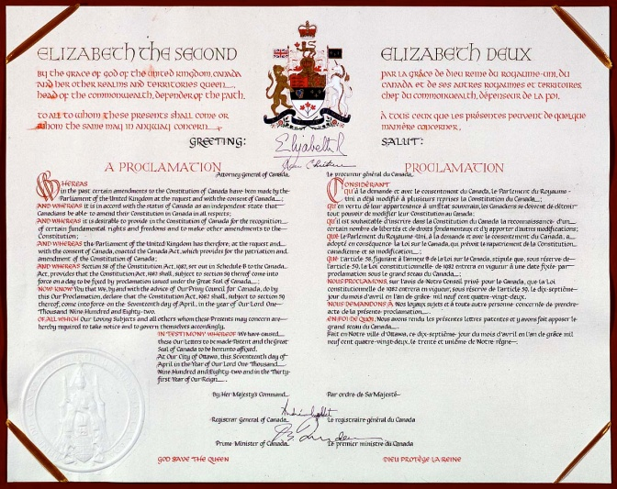
Constitution act - 1982
The Supreme Court of Canada have ruled in their favour over disputes about land, fishing, hunting, and logging.
Many land claims and other forms of agreements have been settled through federal-government process that does not involve going to court.

Slide 10
Metis
Metis groups in Canada have also worked to have their collective rights and identities recognized.
Metis have not had the same historic treaties with the government as some other Aboriginal groups.

Slide 11
Alberta Metis Settlements Accord
In Alberta – 1989- recognition of Metis collective rights occurred when the Alberta Metis Settlements Accord was passed. This created 8 collective Metis Settlements – the only Metis land that is self-governed and constitutionally protected in Canada today.
Manitoba denied a similar Metis claim in the Red River Valley.

Slide 12
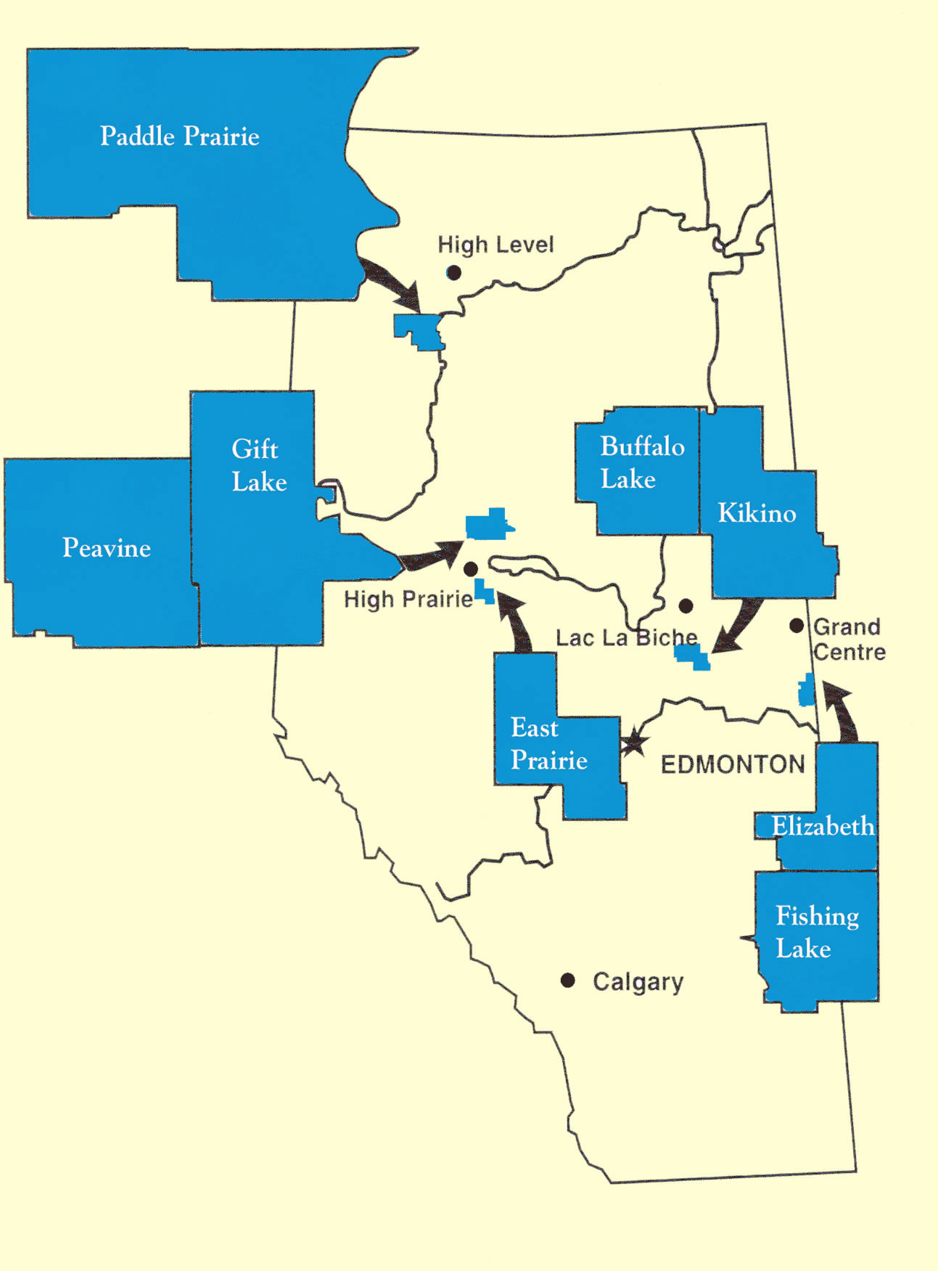

Slide 13
Aboriginal Self-government
First Nations, Metis, Inuit peoples can make their own decisions regarding their economy, education, culture, use of natural resources, and other areas of immediate concern to their wellbeing, rather than having these decisions made by Canada’s federal, provincial, or territorial governments.

Slide 14
Section 35 of the Constitution Act
In 1995 the federal government started a policy to recognize Aboriginal self-government as a collective right under section 35 of the Constitution Act.
This policy included a process for negotiating self-government agreements
Many disagreements still exist because of how diverse self-government can be, and what it should look like in each community.
One of the challenges is how to best incorporate Aboriginal self-government within the framework of Canadian liberalism.

Slide 15
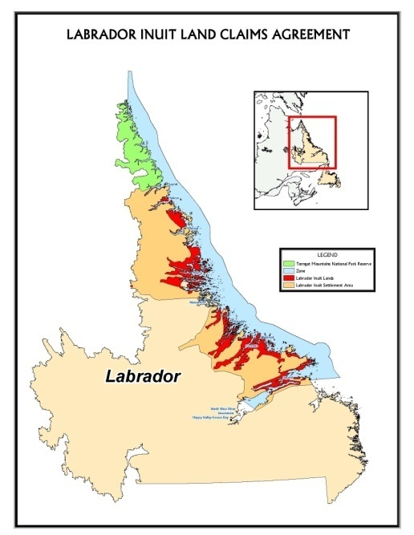
Self-Government: The Labrador Inuit Land Claims Agreement
The Labrador Inuit Land Claims Agreement is a comprehensive land claim agreement, or modern-day treaty, that recognizes the collective rights and identities of the Labrador Inuit by confirming their rights to land ownership in northern
Labrador, self-government,
and resource sharing.

Slide 16
Self-Government: The Labrador Inuit Land Claims Agreement
January 2005, the agreement was signed by the government of Canada, and the government of Nfld. And Labrador.
One important result of the signing of the Labrador Inuit Land Claims Agreement was the creation of the Nunatsiavut transitional government which progress towards self-government

Slide 17
Source Analysis
“In Canada… you negotiate on this… because Aboriginal Rights don’t trump all other rights in the country. You need to consider the people who have sometimes also lived on those lands for two or three hundred years, and have hunted and fished alongside the First Nations” – Chuck Strahl (Indian Affairs Minister of Canada)
1) Is Strahl in favour of liberalism? Why or Why not?
2) What principles would he use to support his position?
3) Why do you think the government of Canada might see the recognition of collective rights as a challenge to liberal values?

Slide 18
Religious Perspectives and Ways of Thinking

Slide 19
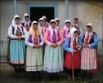
Doukhobors
The Doukhobors were a group of Russian-language speaking dissenters who rejected authority of Church and state.
They came to Canada and the United States from Russia to escape persecution {religious beliefs, pacificm-refusal to participate in military service, and their refusal to recognize a secular (non-religious) government} at the turn of the 20th century.

Slide 20
Doukhobors
Owned and worked land as a community, rather than owning private property as individuals.
These economic expressions seemed closer to communism than individualistic, capitalist society.
In Canada, they refused to take an oath of allegiance, fearing compulsory military service.
Original Sask. Homestead land was taken away, and many Doukhobors moved to BC
Sons of Freedom (Freedomites) established – radical group who protested materialism of capitalism

Slide 21
If individual rights in a liberal democracy are to be respected, should not the Doukhobors been able to live their lives as they wished according to their own model of liberalism?

Slide 22
Challenges to Liberal values
One recent challenge to liberal values in Canada has been the request by religious groups to use religious law, such as on of the many interpretations of Muslim sharia law, to settle legal disputes.
Sharia is a legal framework that can be practiced in many different ways to govern private and public aspects of life for Muslims.
Iran and Saudia Arabia use Sharia fully, and Muslim Canadian want to use these religious principles, instead of secular institutions to settle family law matters.

Slide 23
Challenges to Liberal values
Similarly, some Catholics, Jews and Mennonites have a desire to be governed in family law by the religious principles of their respective faiths.
If some faith based laws are allowed on the grounds of religious freedom, how might they reflect respect for some individual rights and freedoms guaranteed under Canada’s constitution?
How might they also be seen by some to pose a challenge to some individual rights or freedoms in the Canadian Constitution?

Slide 24
Take a Position
Read p 259 – Religion, Sharia, and Human Rights.
Question: To what extent should the Canadian government accommodate cultural or religios practices, such as that of sharia law, that seem to discriminate against women? Why or Why not?

Slide 25
Environmental and Collective Ways of Thinking

Slide 26
Environmentalism
“A political and ethical ideology that focuses on protecting the natural environment and lessening the harmful effects that human activities have on ecosystems”.
Environmental ways of thinking can challenge or align with a society’s liberal values, depending on the society’s interpretation of environmental issues that affect the common good.

Slide 27
Civil Disobedience: Foods not Bombs
Legal appeals, negotiations, lobbying, peaceful protest and community action are essential components of a liberal democracy.
Some groups believe we need to go further with acts ranging from civil disobedience to riots to violent attacks.
Why would people who normally abide the law break the law intentionally and publicly?
Is this ever justified? Why or Why not?

